Slide 1
Vectors and Scalars
Applied Physics

Slide 2
Scalar
Scalar Example | Magnitude
Speed | 20 m/s
Distance | 10 m
Age | 15 years
Heat | 1000 calories
A SCALAR is ANY quantity in physics that has MAGNITUDE, but NOT a direction associated with it.
Magnitude – A numerical value with units.

Slide 3
Vector
A VECTOR is ANY quantity in physics that has BOTH MAGNITUDE and DIRECTION.
Vector | Magnitude & Direction
Velocity | 20 m/s, N
Acceleration | 10 m/s/s, E
Force | 5 N, West
Vectors are typically illustrated by drawing an ARROW above the symbol. The arrow is used to convey direction and magnitude.

Slide 4
Applications of Vectors
VECTOR ADDITION – If 2 similar vectors point in the SAME direction, add them.
Example: A man walks 54.5 meters east, then another 30 meters east. Calculate his displacement relative to where he started?
54.5 m, E
+
30 m, E
Notice that the SIZE of the arrow conveys MAGNITUDE and the way it was drawn conveys DIRECTION.
84.5 m, E

Slide 5
Applications of Vectors
VECTOR SUBTRACTION - If 2 vectors are going in opposite directions, you SUBTRACT.
Example: A man walks 54.5 meters east, then 30 meters west. Calculate his displacement relative to where he started?
54.5 m, E
-
30 m, W
24.5 m, E

Slide 6
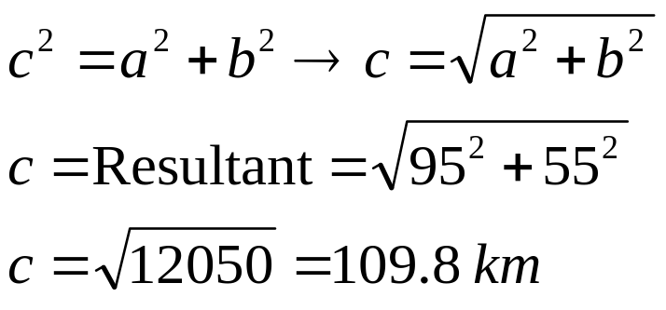
Non-Collinear Vectors
When 2 vectors are perpendicular, you must use the Pythagorean theorem.
A man walks 95 km, East then 55 km, north. Calculate his RESULTANT DISPLACEMENT.
Finish
The hypotenuse in Physics is called the RESULTANT.
55 km, N
Vertical Component
Horizontal Component
Start
95 km,E
The LEGS of the triangle are called the COMPONENTS

Slide 7
BUT……what about the direction?
In the previous example, DISPLACEMENT was asked for and since it is a VECTOR we should include a DIRECTION on our final answer.
N
W of N
E of N
N of E
N of W
W
E
N of E
S of W
S of E
NOTE: When drawing a right triangle that conveys some type of motion, you MUST draw your components HEAD TO TOE.
W of S
E of S
S

Slide 8
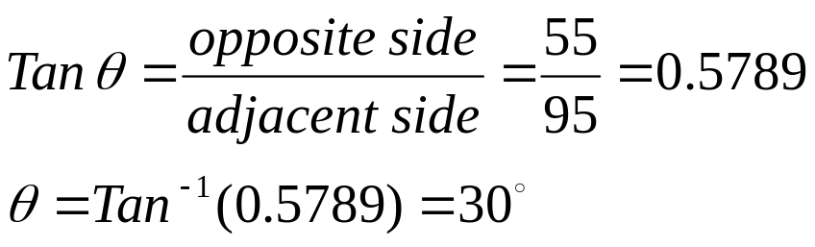
BUT…..what about the VALUE of the angle???
Just putting North of East on the answer is NOT specific enough for the direction. We MUST find the VALUE of the angle.
To find the value of the angle we use a Trig function called TANGENT.
109.8 km
55 km, N
θ
N of E
95 km,E
So the COMPLETE final answer is : 109.8 km, 30 degrees North of East

Slide 9
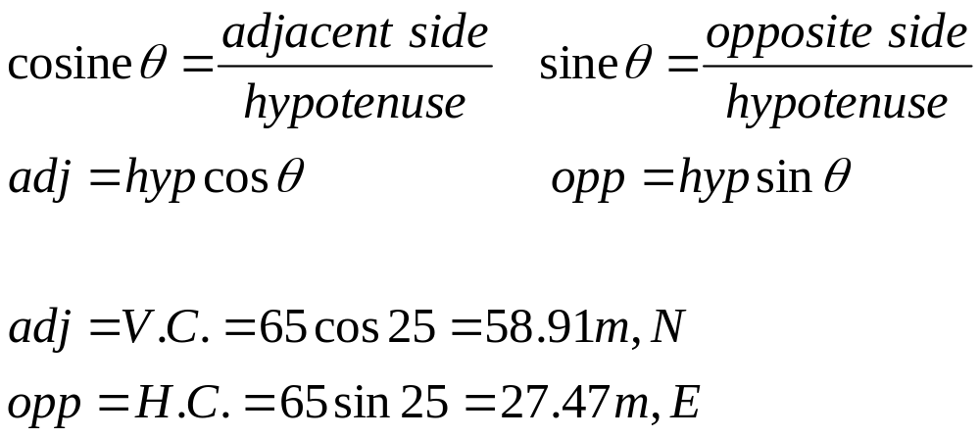
What if you are missing a component?
Suppose a person walked 65 m, 25 degrees East of North. What were his horizontal and vertical components?
The goal: ALWAYS MAKE A RIGHT TRIANGLE!
To solve for components, we often use the trig functions since and cosine.
H.C. = ?
V.C = ?
25
65 m

Slide 10
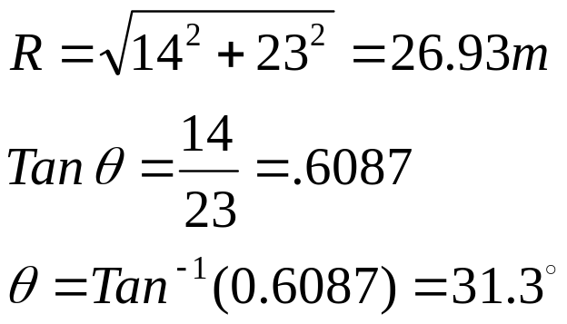
Example
A bear, searching for food wanders 35 meters east then 20 meters north. Frustrated, he wanders another 12 meters west then 6 meters south. Calculate the bear's displacement.
23 m, E
-
=
12 m, W
-
=
14 m, N
6 m, S
20 m, N
35 m, E
R
14 m, N
θ
23 m, E
The Final Answer: 26.93 m, 31.3 degrees NORTH or EAST

Slide 11
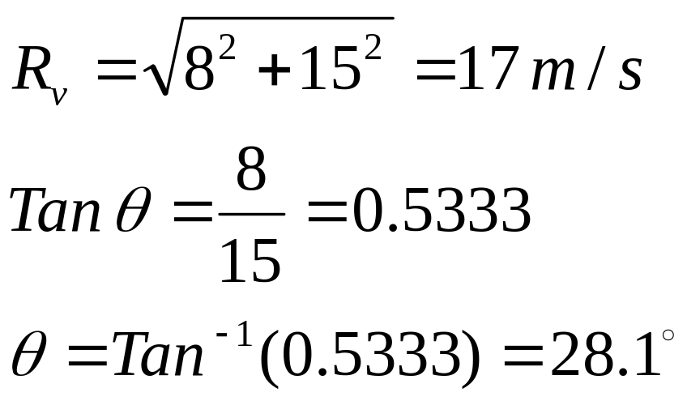
Example
A boat moves with a velocity of 15 m/s, N in a river which flows with a velocity of 8.0 m/s, west. Calculate the boat's resultant velocity with respect to due north.
8.0 m/s, W
15 m/s, N
R_{v}
θ
The Final Answer : 17 m/s, @ 28.1 degrees West of North

Slide 12
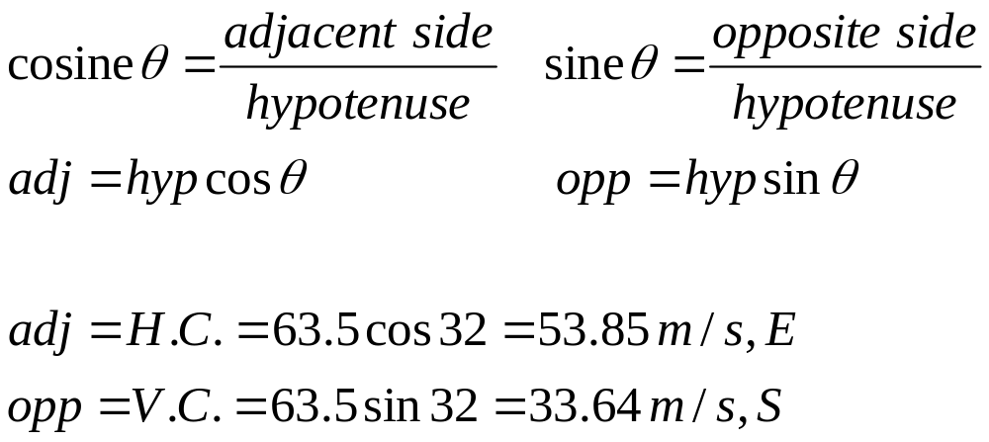
Example
A plane moves with a velocity of 63.5 m/s at 32 degrees South of East. Calculate the plane's horizontal and vertical velocity components.
H.C. =?
32
V.C. = ?
63.5 m/s

Slide 13
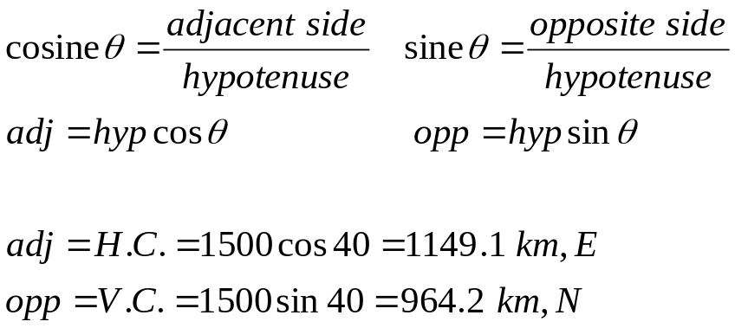
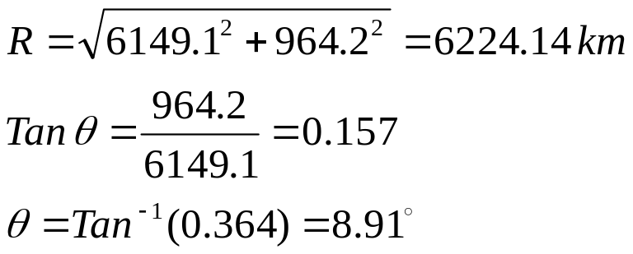
Example
A storm system moves 5000 km due east, then shifts course at 40 degrees North of East for 1500 km. Calculate the storm's resultant displacement.
1500 km
V.C.
40
5000 km, E
H.C.
5000 km + 1149.1 km = 6149.1 km
R
964.2 km
θ
The Final Answer: 6224.14 km @ 8.91 degrees, North of East
6149.1 km

